Slide 1
Tableau Module 5
Data Analytics

Slide 2


























Formats
Common Charts
Data Views
Hierarchies
Data Structures
Basic Navigation
Dashboards
You are here
Data Stories
Calculations
Advanced
Charts
Certification Springs
Blending
Done

Slide 3
Module 5 Learning Outcomes
Demonstrate how to filter null values
Edit geographic locations
Understand number formatting in Tableau
Demonstrate changing display formats

Slide 4
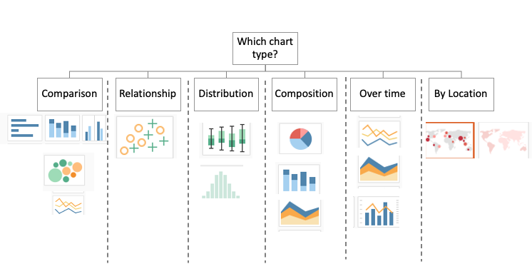
Not aggregated

Slide 5
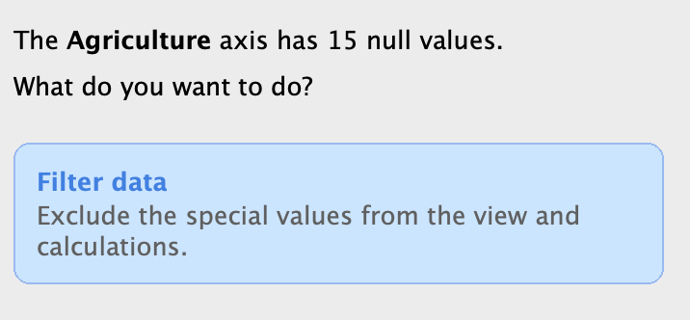
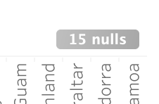
The Trouble with NULL
To display or not to display?

Slide 6
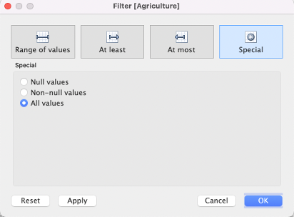
Special Values

Slide 7
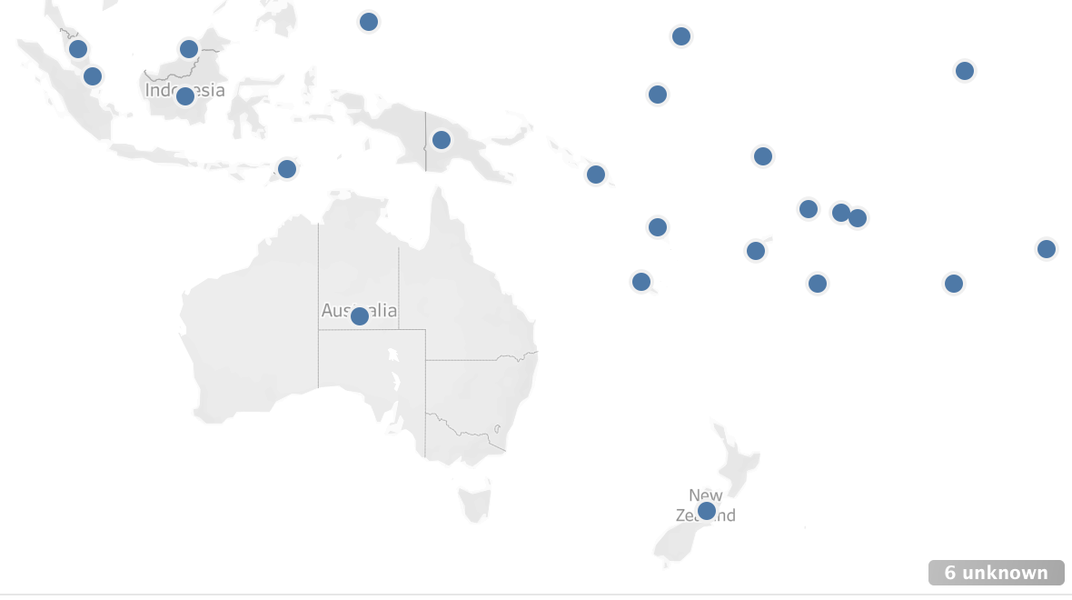
Matching Geographical Locations

Slide 8
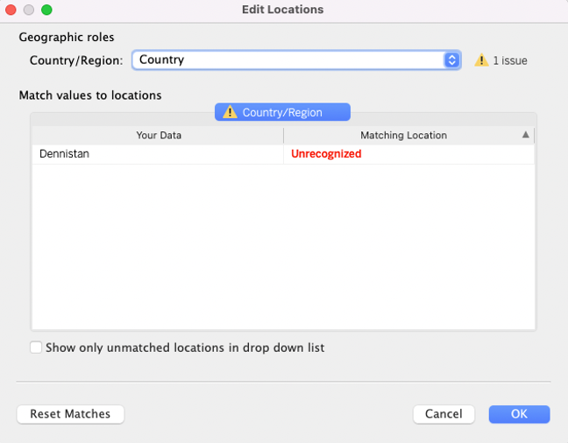
Matching Geographical Locations

Slide 9
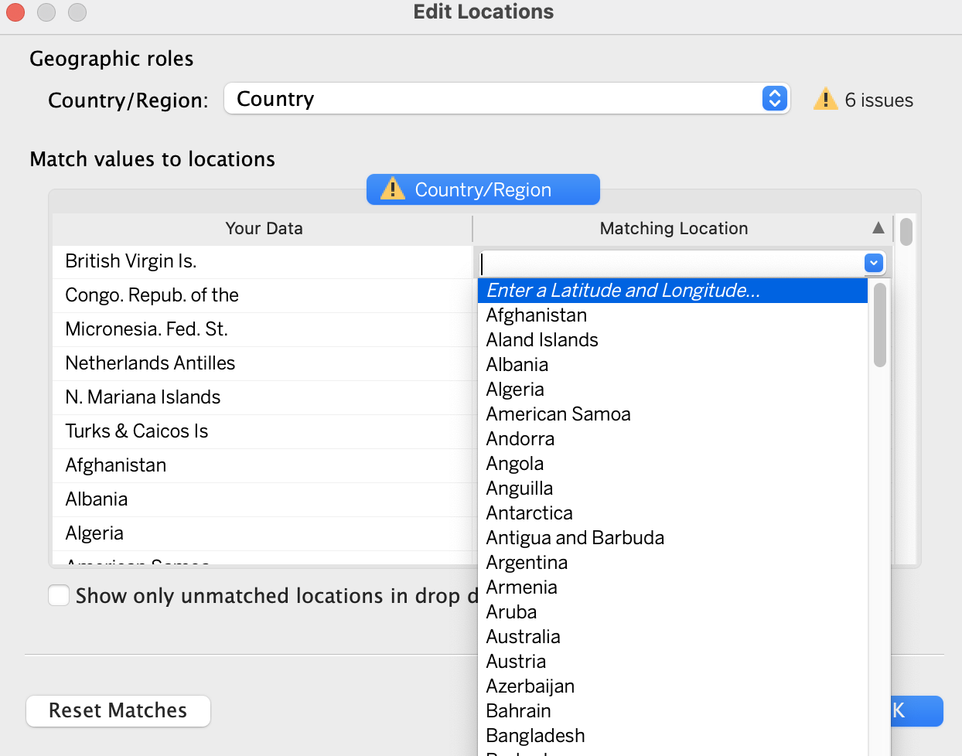
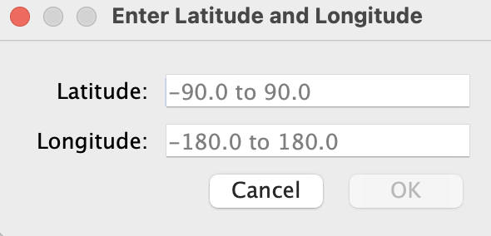
Lat/Lon Geographical Locations

Slide 10
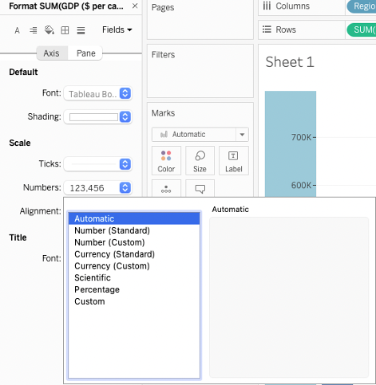
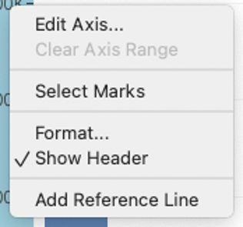
Axis Number Formats
Choose Format, Numbers to change to currency, scientific, percentage, etc.

Slide 11
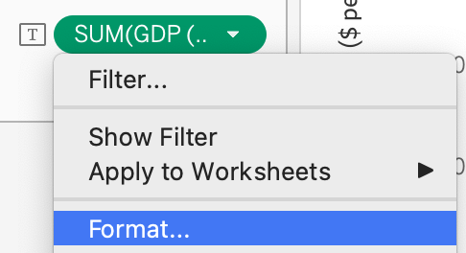
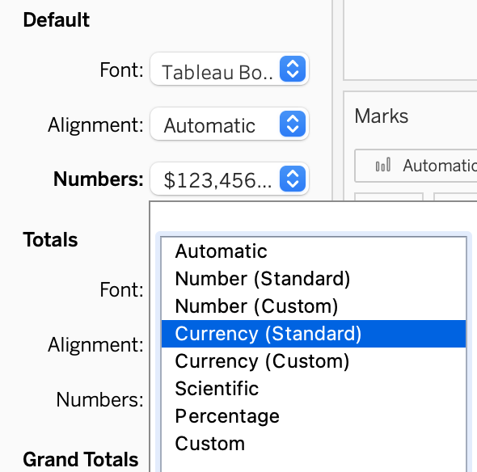
Label Number Formats
Choose Format, Numbers to change to currency, scientific, percentage, etc.

Slide 12
Challenge
Use WorldCountries.csv
Create a horizontal bar chart for region vs. average population
Change the axis labels to 12 pt. black
Change the chart title to ‘Average Population by Global Region’
Change the chart title font to 15 pt bold
Add labels to the bars
Change the labels to dark blue

